Slide 1


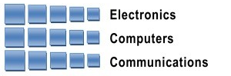
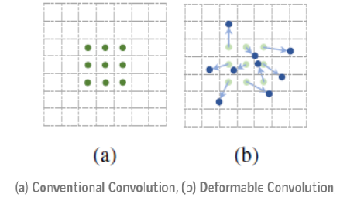
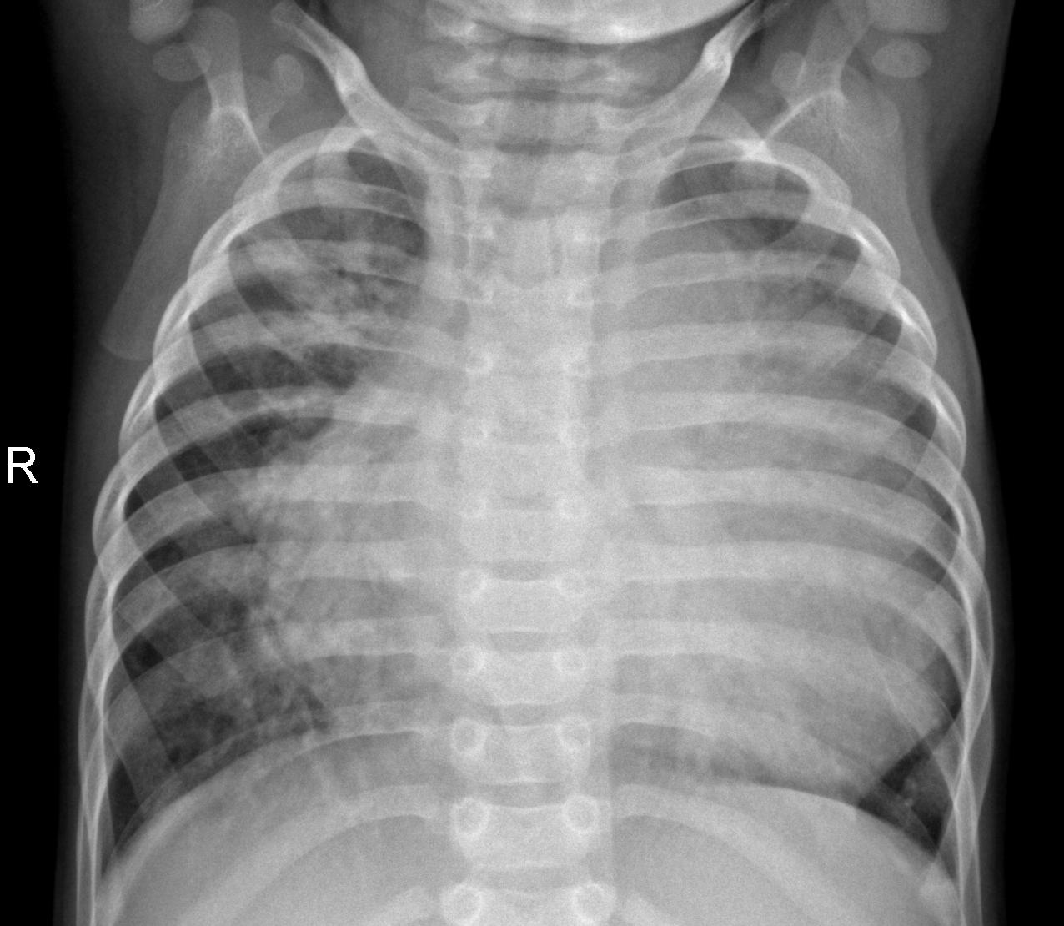
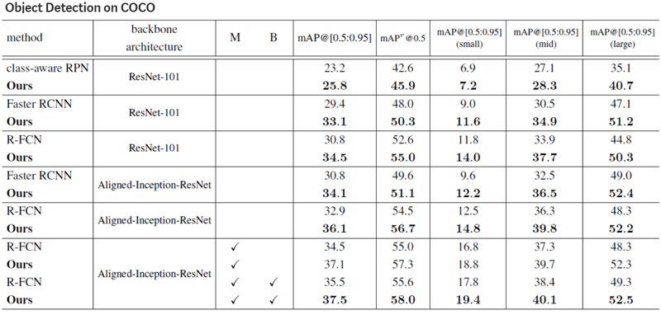
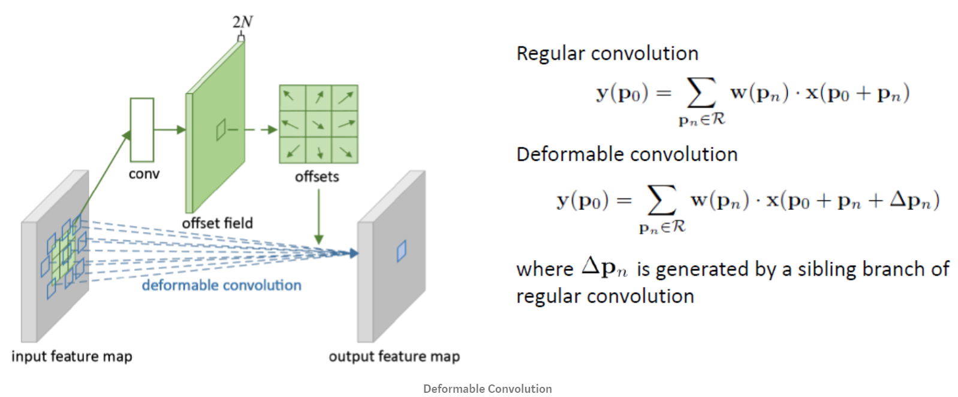
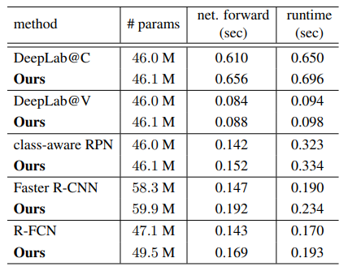
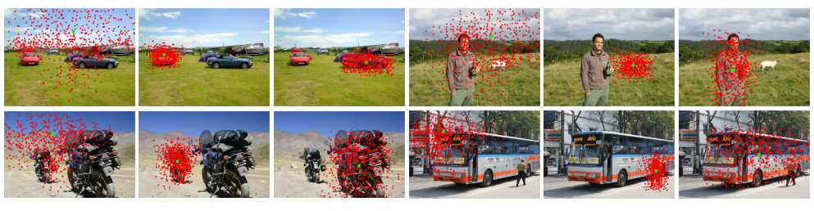
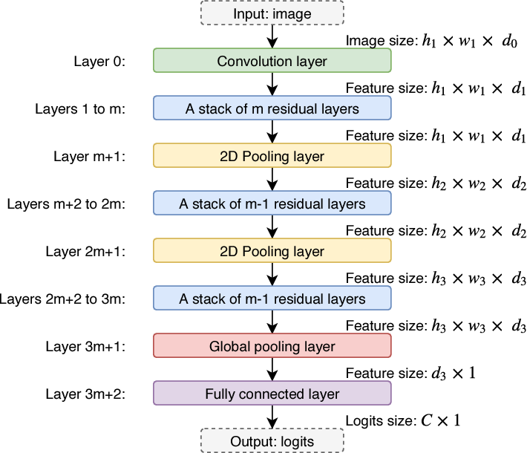

Andrew and Erna Viterbi
Faculty of Electrical Engineering
Work in Progress
Signal and Image Processing Lab
Pneumonia Detection from Chest X-Rays with Robustness to Deformations
Andy Rodan and Or Glassman, Supervised by Yair Moshe
Introduction
Deformable Convolutional Networks
Robustness
Pneumonia affects millions of people and is one of the top 10 causes of death in the USA
Pneumonia can be seen in chest X-Ray as one or more areas of increased opacity in the lung
Quick diagnosis is key to effective treatment
Diagnosis requires examination by medical experts
CNN-based diagnosis steadily improving, still much room for improvement
Use deformable CNNs to address image deformations
Different body positions (laying/standing)
Annotated images (added by medical staff examining the images)
Different body structures
Lung opacity areas vary greatly
Convolution operates on rectangular grid from input image or a set of input feature maps
Objects may be deformed or occluded within image
DCN - each grid point is moved by learnable offset
DCN performance
DCN performed well in COCO Object Detection challenge
Acquire offsets using secondary CNN
X-ray of lungs infected with Pneumonia
No significant overhead for integrating DCN into architecture. From main article:
Goals
Improve diagnosis of Pneumonia using chest X-rays
Address image deformations by implementing deformable networks
Challenges
Filter deforms to acquire target object’s shape
Implementing DCN model into known CNN architectures
Data labeling often ambiguous
Optimize DCN layers for max performance
Intermediate Results
Integrated DCN into last layers of chosen architectures:
AlexNet
ResNet18
ResNet50
Ran on Kaggle x-Ray dataset
Ran on Kaggle RSNA Pneumonia dataset
No significant improvements so far on both datasets
Data
Chosen Solution
Kaggle X-Ray (Pneumonia):
Roughly 6k chest X-ray images
4.5k labeled ‘Pneumonia’
0.9 AUC for best results
Kaggle RSNA Pneumonia Detection Challenge:
Roughly 27k chest X-ray images
Some 10.5k labeled “No Lung Opacity”, 8.6k labeled “Lung Opacity”, rest labeled “No Opacity/Not Normal”
CheXpert Challenge:
About 200k chest X-ray images, 14 labels
16.6k labeled “Pneumonia”, 170k labeled “Normal”
Other diseases also labeled in this dataset
0.93 AUC for best results
All data converted to JPG format (DCM, PNG, etc.)
Conversion, resizing & filtering all executed prior to feeding data to network
Implement known architectures
Train on datasets
Integrate DCN model into architectures
Compare results to traditional CNN architctures
Chosen architectures:
AlexNet
ResNet18
ResNet50
Implement 2 models of DCN: v1, v2
Target final layers in architecture. For Resnet18:
Future work
Add visualization to deformed layers – for better characterization & evaluation
Use on datasets such as COCO, that are known to be improved by using DCN layers
Running DCN on CheXpert challenge
AlexNet, no DCN, DS1, 50 epochs
AlexNet, 4-layer DCN, DS1, 50 epochs
In collaboration with
June 2020

